Slide 1



PEW Retail Dashboard
View in Power BI
Last data refresh:
7/31/2024 8:07:44 PM UTC
Downloaded at:
7/31/2024 8:08:57 PM UTC

Slide 2
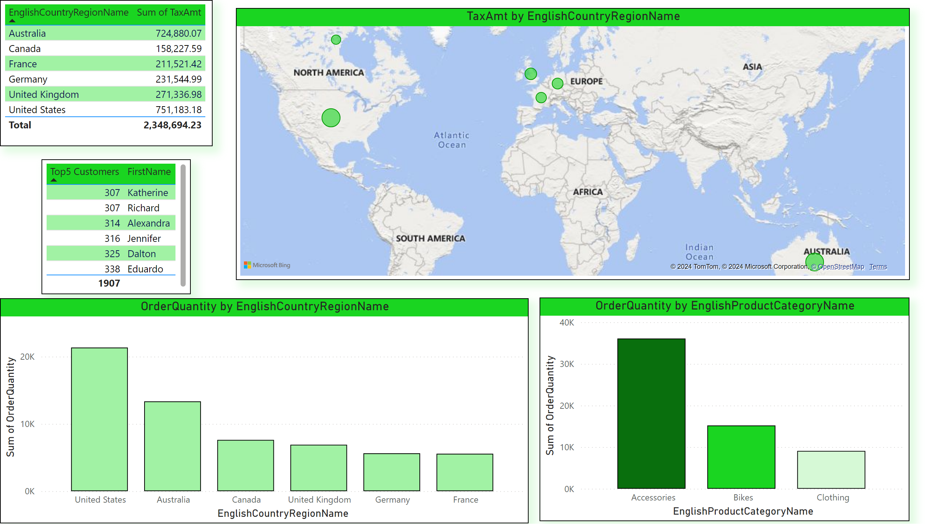
PEW Retail Dashboard
Notes:
OrderQuantity by EnglishProductCategoryName
No alt text provided
tableEx
No alt text provided
OrderQuantity by EnglishCountryRegionName
No alt text provided
tableEx
No alt text provided
TaxAmt by EnglishCountryRegionName
No alt text provided

